Slide 1
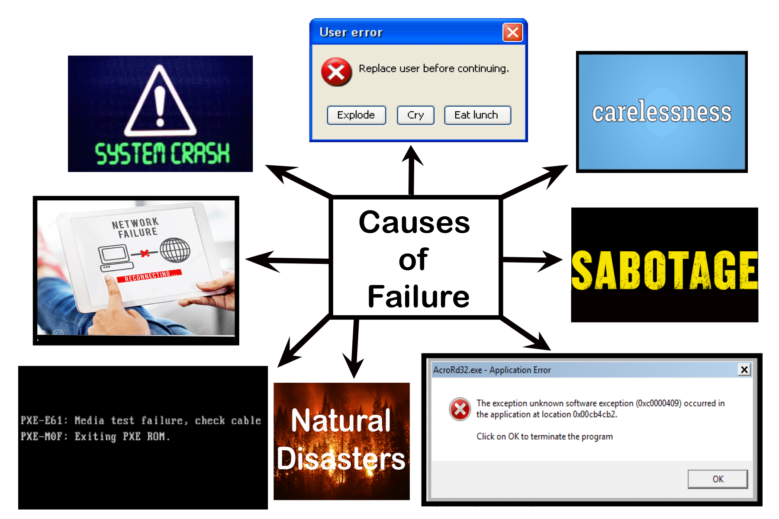
Classifying Failures And Their Impact On The Database
Database Management System (DBMS)
Amit Paudel
BCSIT-III

Slide 2
Scenario
"Imagine you are managing the database of a large e-commerce platform. The platform stores critical customer data, transaction logs, product information, and inventory records.
Due to the high volume of transactions, the system is susceptible to various types of failures. Your team needs to implement a robust backup and recovery system to ensure the availability, consistency, and integrity of the data in case of failures like system crashes, hardware malfunctions, or software bugs.“
Questions:
What types of failures can occur in an e-commerce database system (e.g., hardware, software, human error), and how do these failures affect data integrity and availability?
How would you classify the failure if a user’s transaction is only partially processed due to a system crash?
What mechanisms would you put in place to prevent system failure from leading to catastrophic data loss in a busy e-commerce platform?

Slide 3

Types Of Failures In An E-commerce Database System
E-commerce platforms handle critical and sensitive data such as customer details, transaction logs, and inventory records.
Failures in such systems can disrupt operations, impact customer trust, and lead to financial loss.

Slide 4

1. Hardware Failure
In a busy e-commerce platform, hardware failures can significantly disrupt operations, compromise data integrity, and lead to downtime.
Examples:
Disk Failures: Hard drive crashes can result in loss of stored data or corrupted database files.
Power Outages: Unexpected power failures can lead to abrupt shutdowns, causing incomplete transactions or corrupted data.
Server Crashes: Issues with physical servers hosting the database can make the database inaccessible.

Slide 5
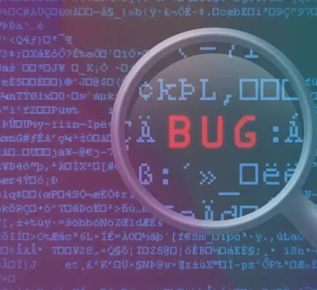
2. Software Failure
Software failures can arise from bugs, misconfigurations, or performance bottlenecks. These failures disrupt system operations, compromise data integrity, and degrade user experience. Examples:
Database Management System (DBMS) Bugs: Errors in the DBMS can cause crashes or incorrect processing of transactions.
Application Bugs: Issues in the application layer can lead to unexpected database queries or updates.
Operating System Issues: Problems with the underlying operating system can result in system crashes.

Slide 6

3. Human Error
Human error is a significant factor that can lead to disruptions in operations, data inconsistencies, and even downtime in an e-commerce platform. These errors can occur during system configuration, operation, or maintenance and may affect various aspects of the platform.
Accidental Deletion: Unintended execution of DELETE or DROP commands.
Misconfigurations: Incorrect setup of database parameters like storage paths or indexing.
Improper Query Execution: Running poorly optimized queries that overload the database.

Slide 7
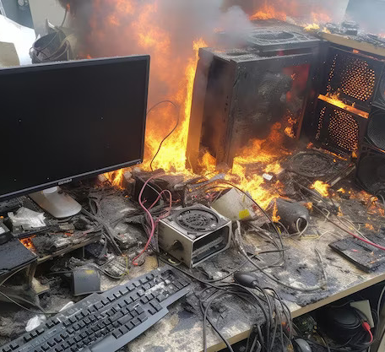
4. Natural Disaster
Natural disasters such as earthquakes, floods, hurricanes, or fires can pose significant risks to your e-commerce platform by disrupting infrastructure and causing potential data loss or system downtime.
Floods, Fires, or Earthquakes: Physical damage to the data center.
Widespread Power Outages: Extended outages affecting infrastructure availability.

Slide 8
Affect On Data Integrity And Availability
Failures such as hardware issues, software bugs, human errors, and natural disasters can significantly impact data integrity and availability in an e-commerce platform.
Hardware failures like disk crashes or power outages can corrupt or permanently destroy critical data, making it inaccessible until recovery systems are activated.
Software failures, including application bugs or database misconfigurations, can lead to partial or incorrect data processing, causing inconsistencies in transactional records or inventory data.
Human errors, such as accidental deletion of files, misconfigurations, or deployment mistakes, can disrupt services and introduce inconsistencies in stored information
Natural disasters like earthquakes, floods, or fires can physically damage infrastructure and servers, potentially resulting in total data loss or prolonged service outages if adequate backups and redundancies are not in place.

Slide 9

Classification Of Failure: Partially Processed Transaction Due To System Crash
When a user’s transaction is only partially processed because of a system crash, it primarily represents a transaction-level failure and can also have overlapping effects of a system-level failure.

Slide 10

1. Transaction failure
The transaction failure occurs when it fails to execute or when it reaches a point from where it can't go any further. If a few transaction or process is hurt, then this is called as transaction failure. Reasons:
Logical errors: If a transaction cannot complete due to some code error or an internal error condition, then the logical error occurs.
Syntax error: It occurs where the DBMS itself terminates an active transaction because the database system is not able to execute it. For example, The system aborts an active transaction, in case of deadlock or resource unavailability.

Slide 11

2. System Crash
System failure can occur due to power failure or other hardware or software failure. Example: Operating system error
Fail-stop assumption: In the system crash, non-volatile storage is assumed not to be corrupted.

Slide 12

Mechanisms to Prevent System Failure from Leading to Catastrophic Data Loss in a Busy E-commerce Platform
In a busy e-commerce platform, preventing catastrophic data loss requires a combination of proactive mechanisms to ensure data integrity, resilient systems to handle failures, and recovery solutions for quick restoration of operations.
Regular Backup
By regularly backing up your data, you can instantly use the last saved instance and get back in action, ensuring that your data loss due to hardware failures, cyberattacks, or human errors is minimized.

Slide 13
2. Data Monitoring
Database monitoring is a systematic approach that helps you monitor your database systems and closely monitor their network and database performance.
This allows you to gain deep insights into the behavior and performance of your entire database, enabling you to identify slow queries
3. Query optimization
Most databases can be accessed using queries, making query execution essential to maintaining database performance and effectiveness. Query Analysis, Indexing, Query rewriting are some of key strategies.
4. Resource management
Allocating sufficient resources to your database is essential for optimal performance and preventing bottlenecks. Proper resource management involves: Hardware and software resources
5. Access control
Protecting your database from unauthorized access is crucial for maintaining data integrity and security. Access controls allow you to provide every user with limited access to your network and overall infrastructure, protecting it from any unauthorized access.

Slide 14
Conclusion
To ensure data integrity and availability in a large e-commerce platform, it is essential to address hardware failures, software glitches, human errors, and natural disasters with robust backup, recovery, and redundancy systems.
Implementing cloud-based solutions, real-time replication, and disaster recovery plans minimizes downtime and data loss. Proactive measures, automation, and regular testing ensure resilience, maintain operations, and uphold customer trust even during unexpected failures.

